Slide 1
The Idea
We can identify correlative data that will allow us to predict oil price into the future.
We can identify correlative data that will allow us to predict oil price movement up or down into the future.
We will use sentiment, machine learning, and deep learning to meet these objectives.

Slide 2
Data Acquisition
Oil Price | Yahoo Finance
GDP | Macrotrends.net
Housing Starts | Macrotrends.net
Oil Production | OECD
Vader | Twitter
Text Blob | Twitter

Slide 3
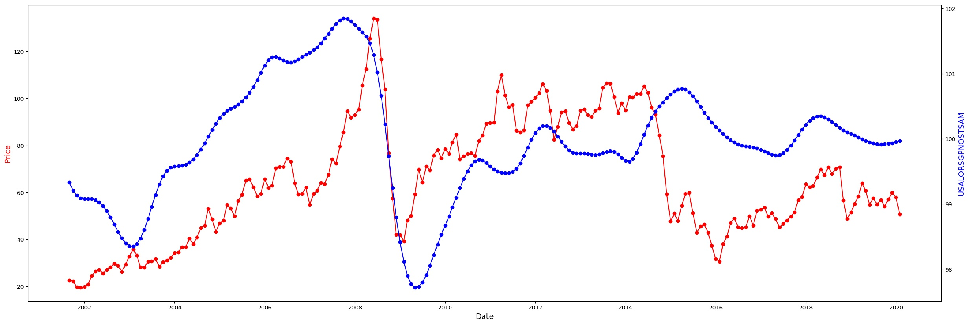
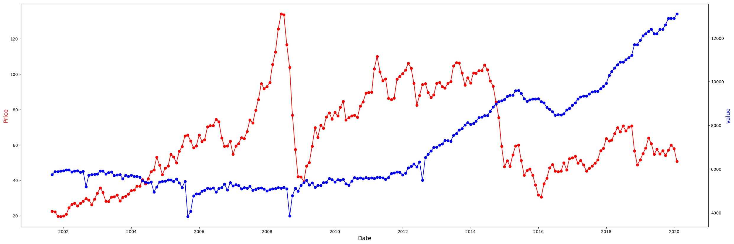
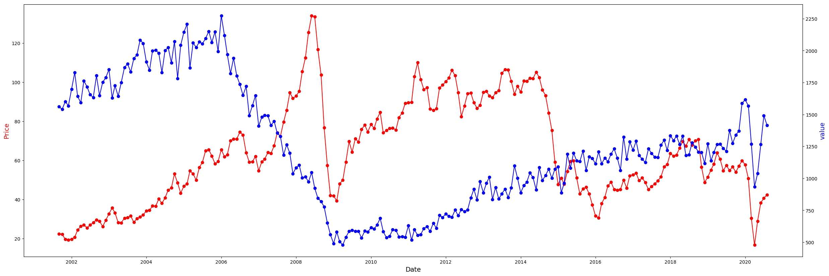
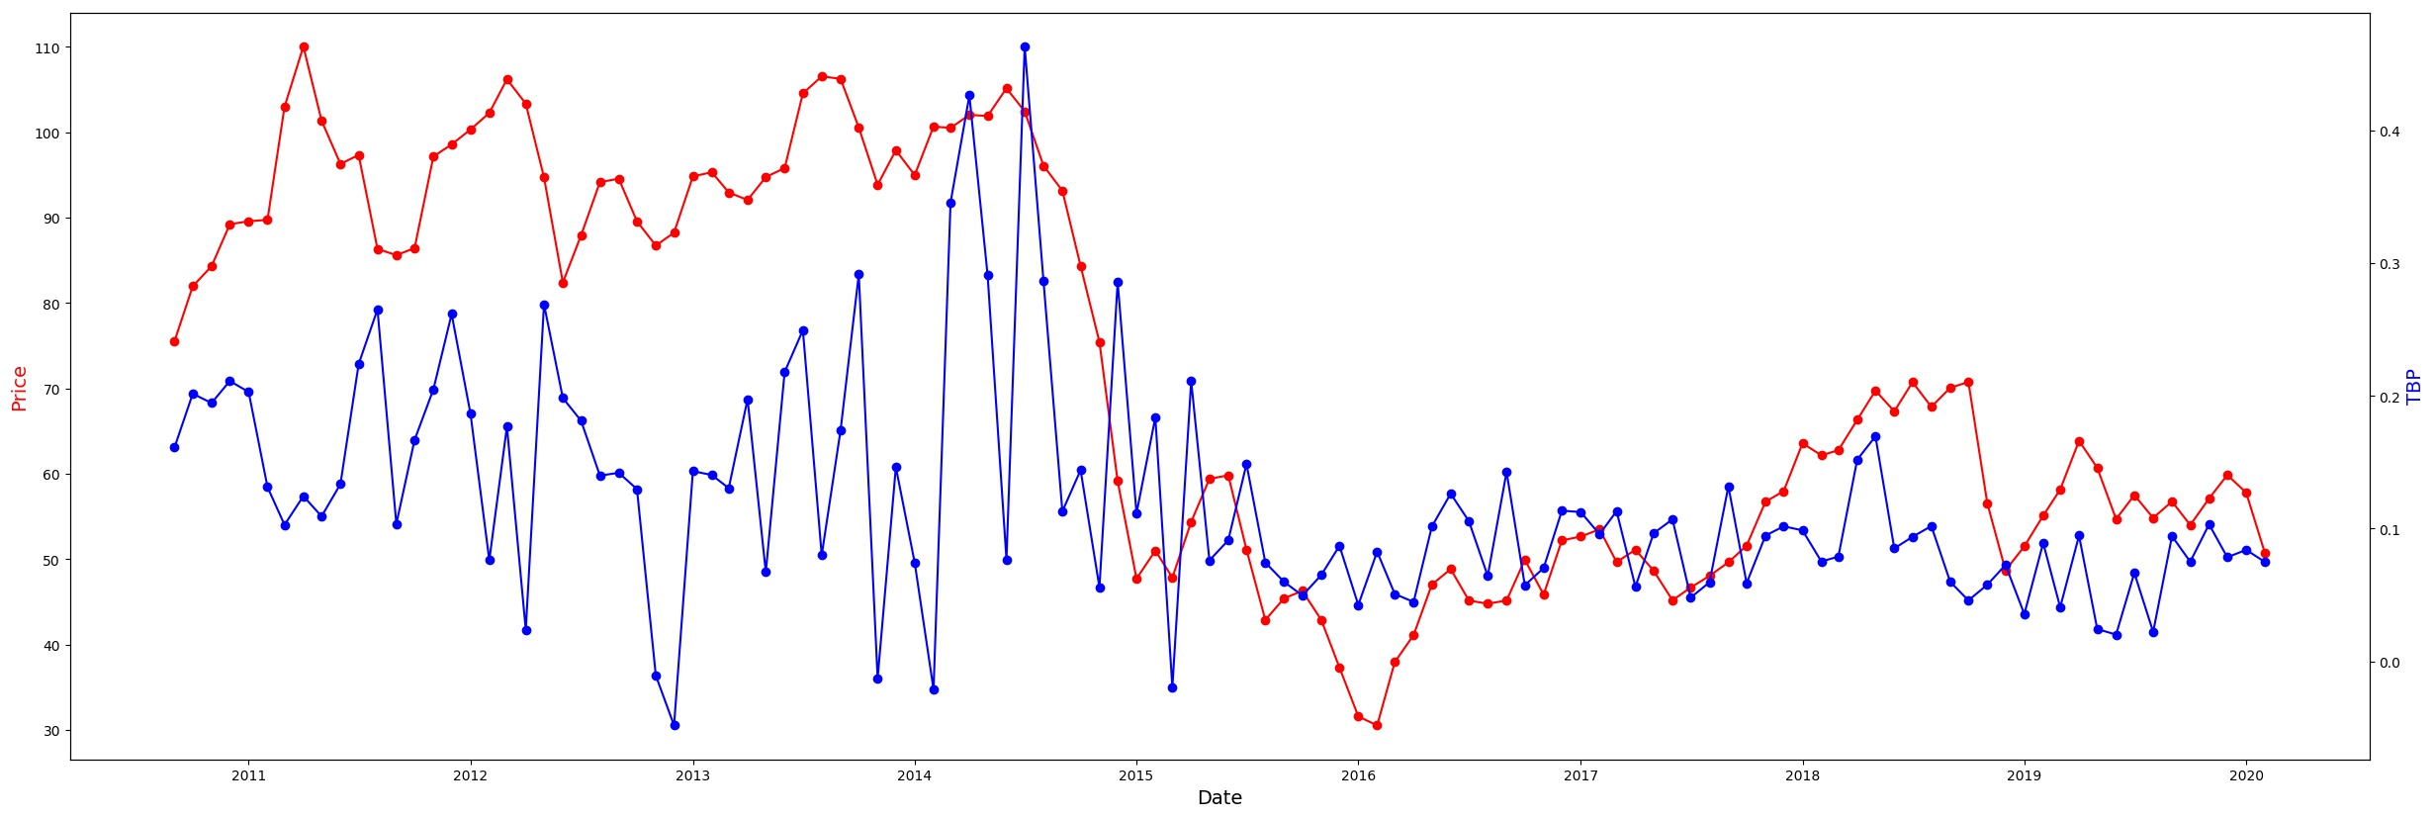
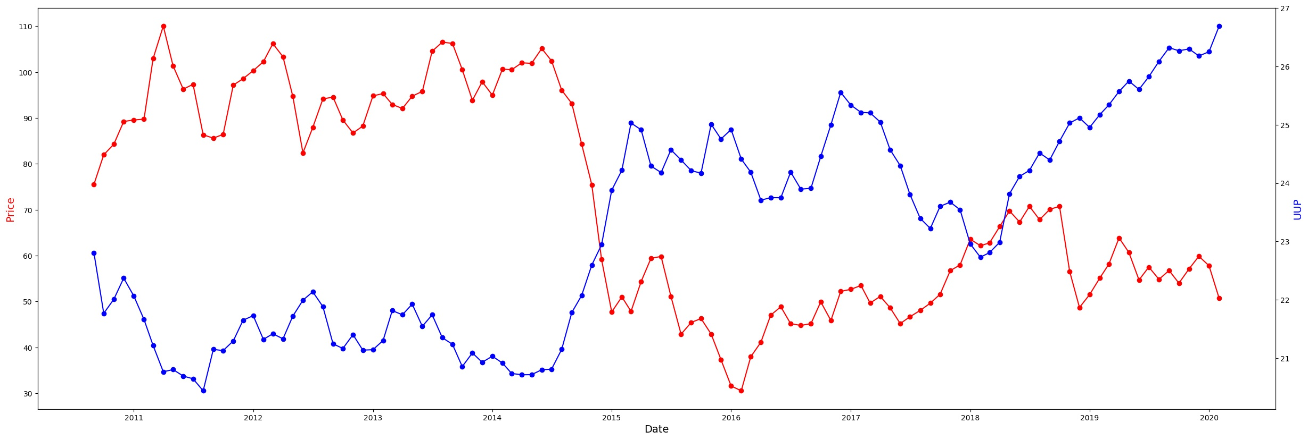
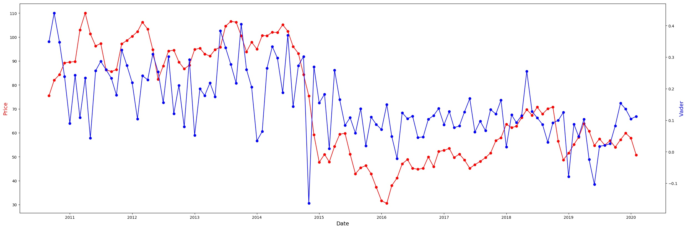
Visually Correlated?
Note: World Oil Production Data not available
GDP
Oil Production
Housing Starts
Text Blob Polarity
UUP
Vader

Slide 4
Oil Price Prediction Effort
Data Acquisition Assess Data Options Proxies/Supply|Demand | Data Cleanse/Prep Data Fill – Average – Manipulation(fill-linear)
Sentiment Twitter Sentiment | Initial Test Correlations Visualize/Graph Random Walk ADFuller/Trend
Modelling Combine Data Regression/Price Classification/Up or Down Neural Network | Interpretation/Interation Modelling Conclusions Determine Next Steps Data Manipulation Data Acquisition

Slide 5
Poor Linear Regression Results

Slide 6
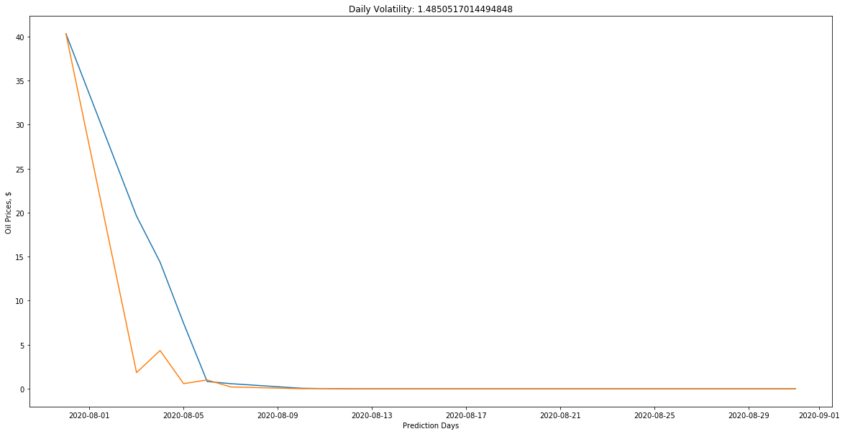
Random Walk

Slide 7
Classification Models
LDA | QDA
DTC | ETC
ADABoost | Bagging
Gradient Boosting | Extra Tree Ensemble
Random Forrest | Ridge
SGD | BNB
GNB | KNN
MLP | LSVC
NuSVC | SVC

Slide 8
AUC Performance Curves
Daily Binary AUC
Daily Continuous AUC
Monthly Binary AUC
Monthly Continuous AUC

Slide 9
Feature Importance
Daily Binary
Daily Continuous
Note: GDPs relative change was may be too small day to day; perhaps better to scale all data then calculate percent change, then binary.
Monthly Binary
Monthly Continuous
Note: UUPs relative change was too small month to month; perhaps better to scale all data then calculate percent change.

Slide 10
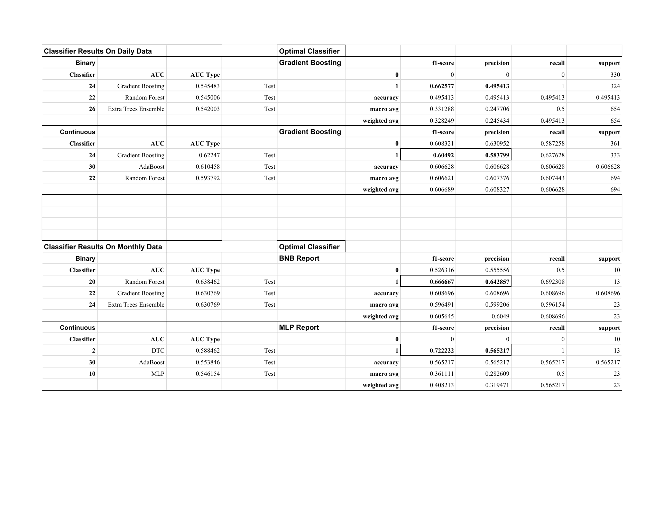
Classifier Reports

Slide 11
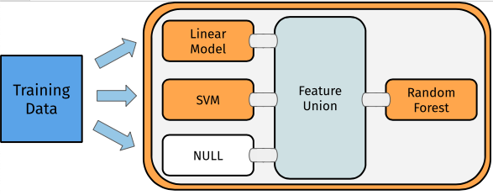
Model, Eval &
Performance
LSTM + Random forest
What models were appropriate for the business outcomes?
LSTM + Random Forest
What were the outcomes of your evaluation?
Next day trend : up or down
Did you take a step to optimize your parameters?
Loss curve
What were the final evaluation metrics for your final consideration set of models?
LSTM
LSTM
LSTM

Slide 12
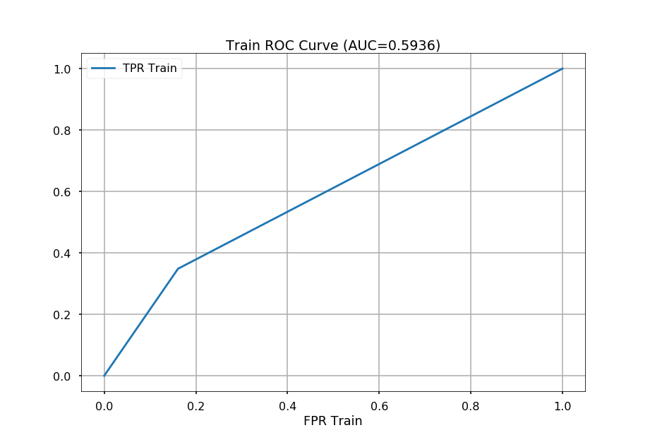

Slide 13
Oil Price Prediction Effort
Data Acquisition Assess Data Options Proxies/Supply|Demand | Data Cleanse/Prep Data Fill – Average – Manipulation(fill-linear)
Sentiment Twitter Sentiment | Initial Test Correlations Visualize/Graph Random Walk ADFuller/Trend
Modelling Combine Data Regression/Price Classification/Up or Down Neural Network | Interpretation/Interation Modelling Conclusions Determine Next Steps Data Manipulation Data Acquisition

